Slide 1
Beer Analysis
Omid Mehrpour
Christopher Haub

Slide 2
Introduction
Two datasets were used to analyze beer brewed in The United States. The date included the brewery, including the city and state the brewery was located in, as well as the style of beer. The data also included the alcohol beverage volume (ABV), international bitterness units (IBU), beer ID and brewery ID.
Analysis of statistical significance and correlations of data was performed to better understand beer.

Slide 3
How many breweries are in each state?
AK 7
AL 3
AR 2
AZ 11
CA 39
CO 47
CT 8
DC 1
DE 2
FL 15
GA 7
HI 4
IA 5
ID 5
IL 18
IN 22
KS 3
KY 4
LA 5
MA 23
MD 7
ME 9
MI 32
MN 12
MO 9
MS 2
MT 9
NC 19
ND 1
NE 5
NH 3
NJ 3
NM 4
NV 2
NY 16
OH 15
OK 6
OR 29
PA 25
RI 5
SC 4
SD 1
TN 3
TX 28
UT 4
VA 16
VT 10
WA 23
WI 20
WV 1
WY 4

Slide 4
Merged Data Sets
Two datasets were merged.
To make one usable dataset to analyse the data.
Beer Dataset
The first dataset was title Beers and contained the name of beer, beer ID, ABV, IBU, brewery Id, style and ounces.
Breweries Dataset
The second dataset was titled Breweries and contained the brew ID, name of brewery, city and state.
Brewery ID
The datasets were merged on Brewery_id, after Brew_ID in the Breweries dataset was changed to Brewery_id.

Slide 5
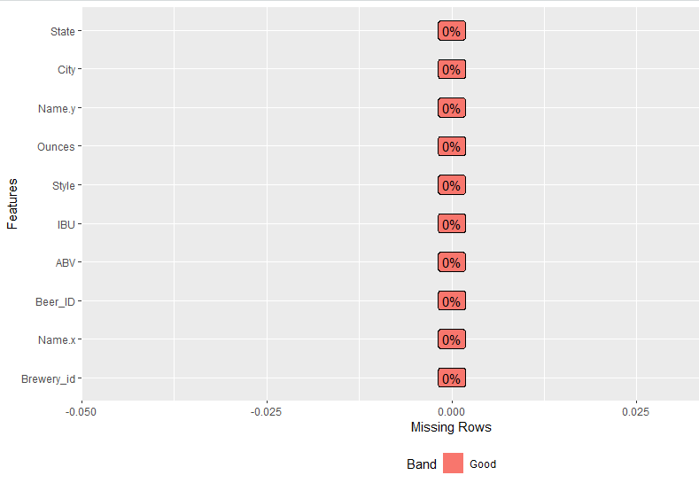
Missing Values, NA’s
Missing Values Replaced
ABV and IBU Columns contained missing values. The ABV column contained 62 missing values and IBU column contained 1,005 missing values. Since ABV contained a smaller number of missing values, we used state level medians to replace those values. IBU contained a lot of missing values. Because of that we used a predictive regression model to predict IBU value based on ABV.

Slide 6
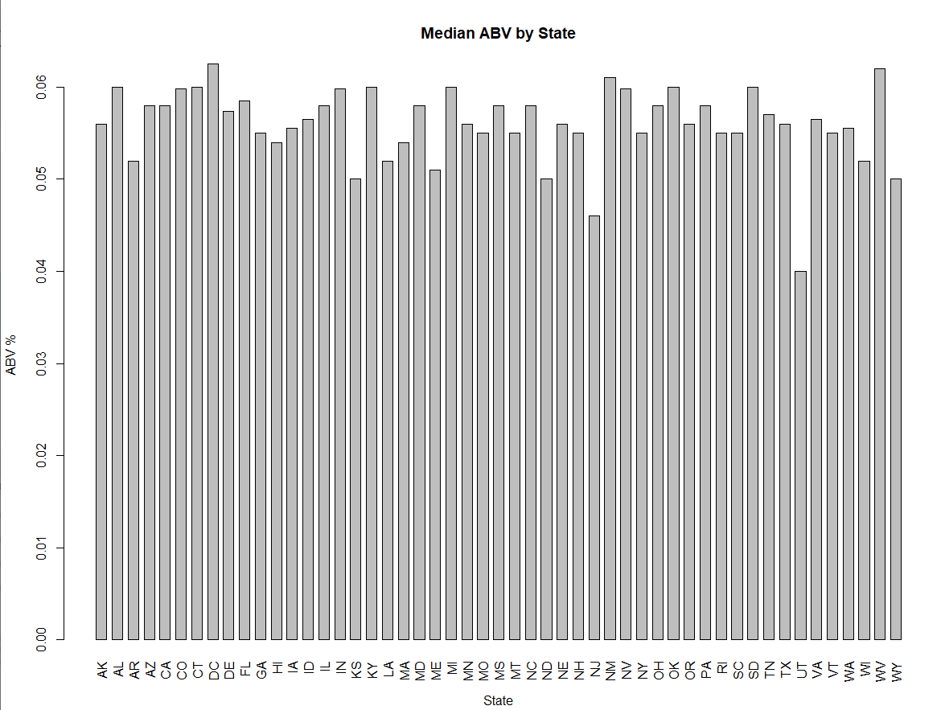
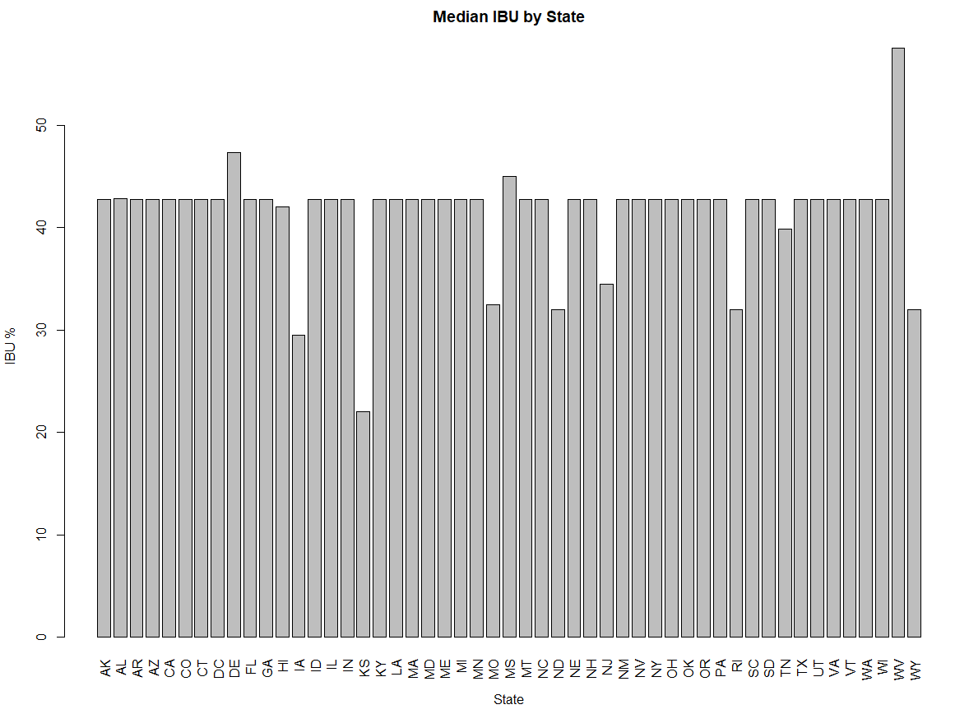
Median ABV and IBU for each state
ABV has a mean of 5.97%, with a median of 5.7%. The maximum ABV is 12.8%, the minimum ABV is .1%.
IBU has a mean of 42.71, with a median of 42.71. The maximum IBU is 138, the minimum IBU is 4.

Slide 7
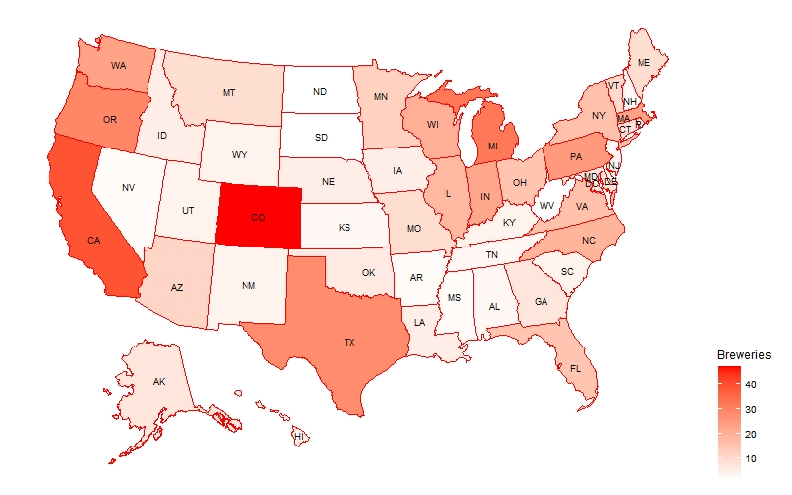
Breweries by state
Colorado has highest number(47) of breweries and, California has with 39 breweries which is in second place. In Colorado most breweries are in Boulder and Denver. Also, California most breweries are in San Diego.

Slide 8
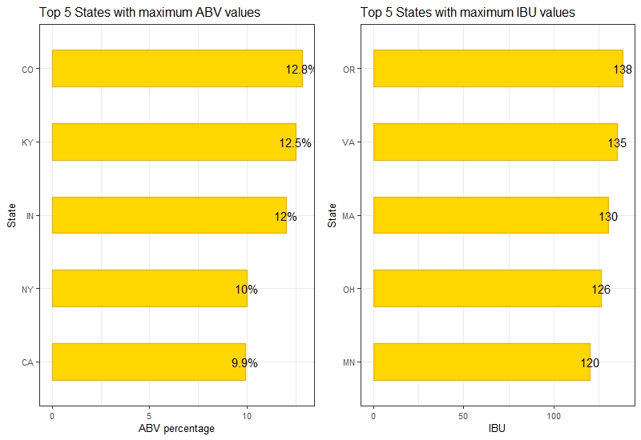
Maximum ABV and IBU Beers
Colorado Highest ABV
Oregon Highest IBU
Had the highest ABV beer at 12.8%
Had the highest IBU at 13.8%

Slide 9
Summary Statistics and distribution of the ABV variable
Summary
P Value
Lowest ABV is 0.1%, highest is 12.8%. Mean is 5.98% (average), median is 5.6% (middle). Due to large sample skew, median is most likely a more accurate representation of the data.
P value does not have normal distribution as it is very small (non normal distribution). Skewed away fr mean.

Slide 10
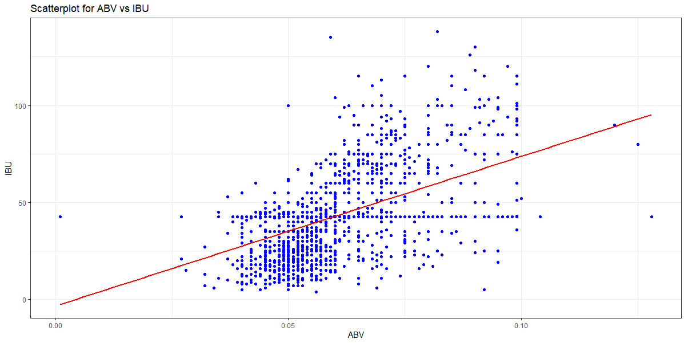
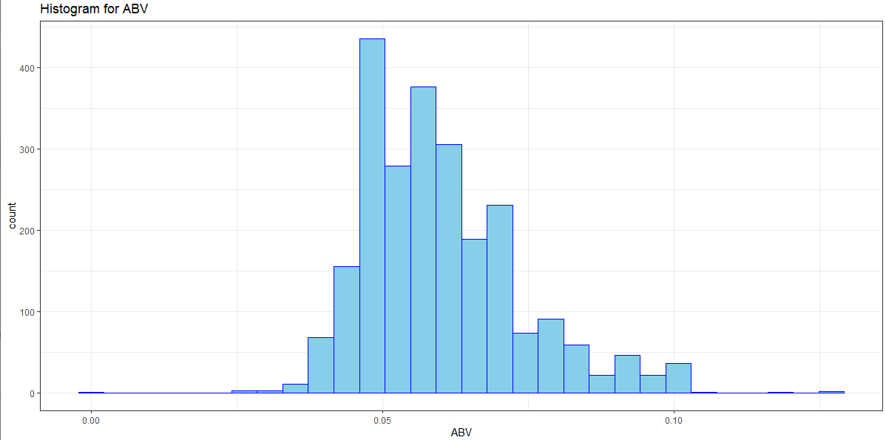
Relationship between bitterness of beer and its alcohol content
Correlation Test
.52 correlation, some correlation between the bitterness of beer and its alcoholic content, however it is not strong (scale -1 to 1). Somewhat as alcohol content increases bitterness increases however it is not hard to find values outside of this assumption.

Slide 11
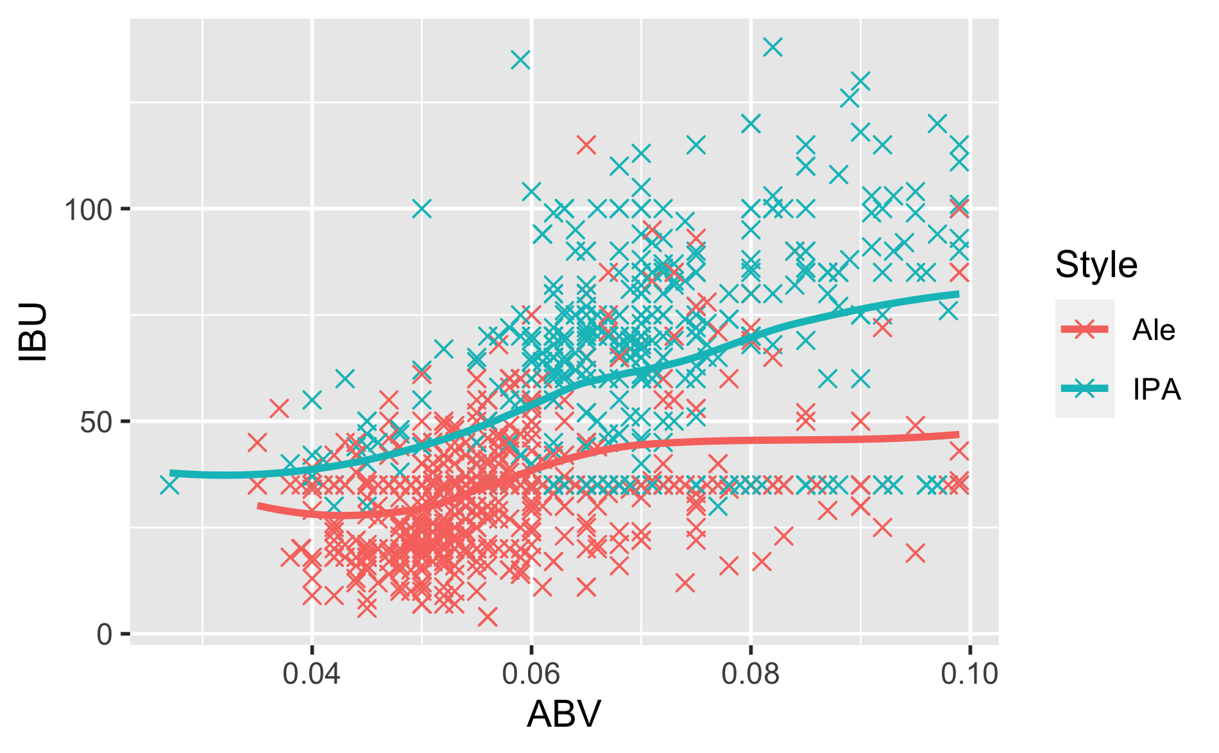
Relationship between ABV and IBU in different styles

Slide 12
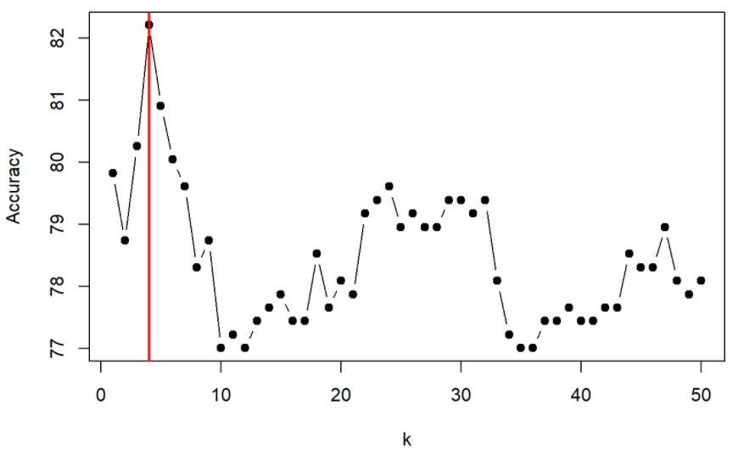
KNN Model for distinguishing IPA and ale
Accuracy 86.27%
Misclassification Rate 0.14
Sensitivity 0.82
Specificity 0.89

Slide 13
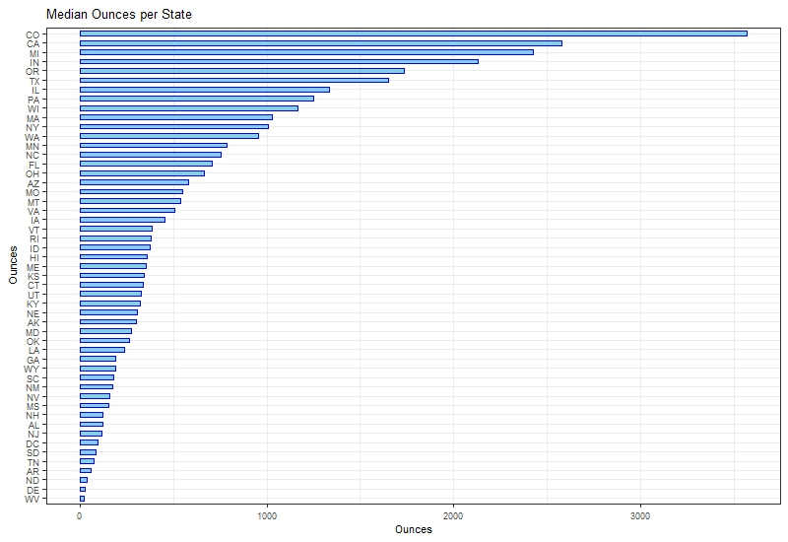
Ounces by state

Slide 14
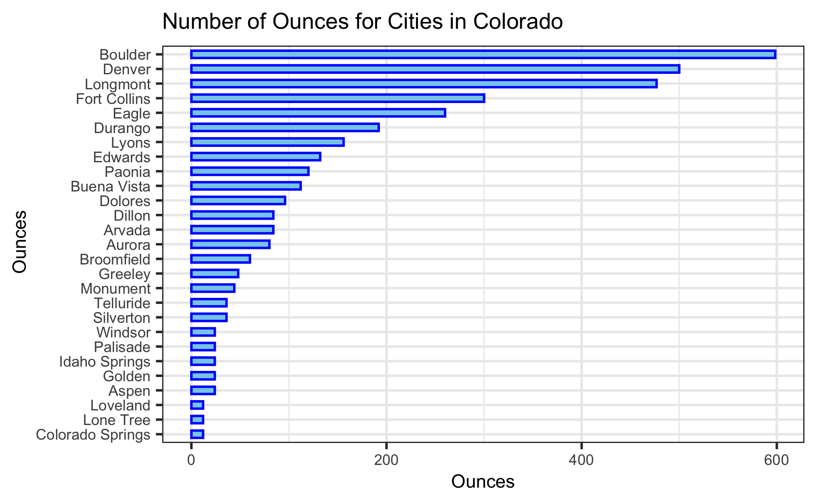
Ounces per cities in Colorado
Mann-Whitney test showed that ounces was similar in IPA and Ale in Colorado(p>0.05)

Slide 15
THANK YOU
YOUTUBE PRESENTATION
https://youtu.be/rYsXI5dLb5o
Christopher Haub
Omid Mehrpour

